Slide 1

Machine Learning for Industrial Data Task 2 “IMDB Predicting movie genre”
Student Ivan Smirnov
Group J42332c

Slide 2
Task
Collect data from IMDB
To predict the genre of a film from a pre-approved list of categories based on the title, poster (image), and a synopsis of the film.
2

Slide 3
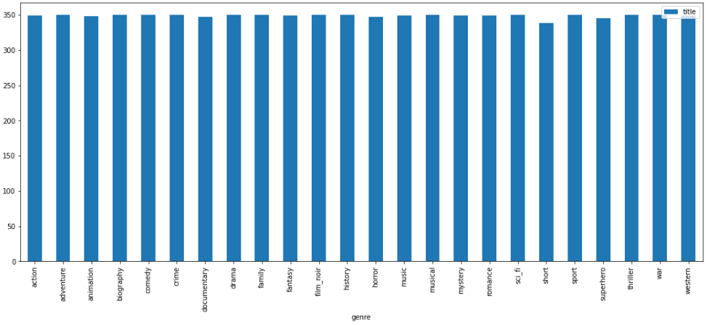
Data collecting
Requests + BeautifulSoup.
Collected 350 films for every genre
3

Slide 4
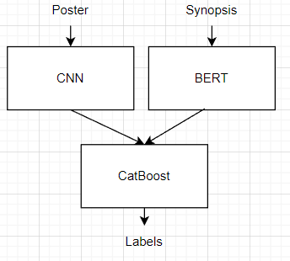
Approach
Was solving multilabel problem
Were using models for each modality and CatBoost to consider both
Pipeline of solution
4

Slide 5
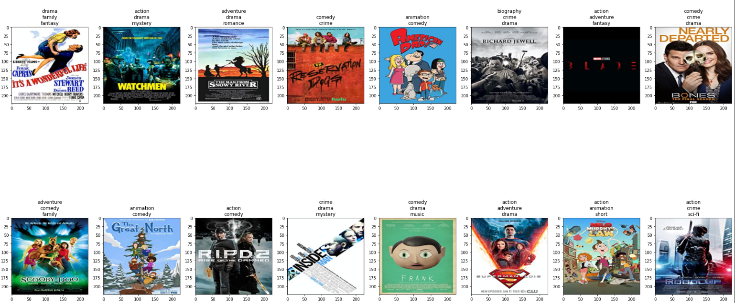
CNN model
Example of batch
5

Slide 6
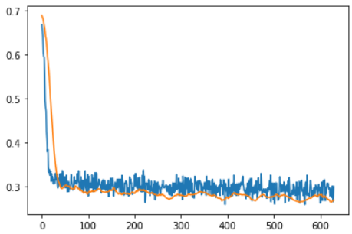
CNN model
Was used pretrained EfficientNetV2 model
Loss values on train and validation data per iterations
6

Slide 7
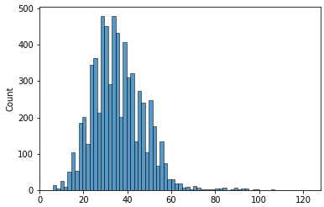
BERT model
To train model, was used Pytorch Lightning
Tokenizer size = 128
Trainer stopped on 15 epoch because of early stopping rule
train_loss=0.0465, val_loss=0.128
Distribution of number of tokens
7

Slide 8
CatBoost find hyperparameters
RandomizedSearchCV for tuning. Criteria – Multi Cross Entropy
Scoring – f1_micro.
Best parameters:
'learning_rate': 0.0001 'l2_leaf_reg': 0.0001
'depth': 4
8

Slide 9
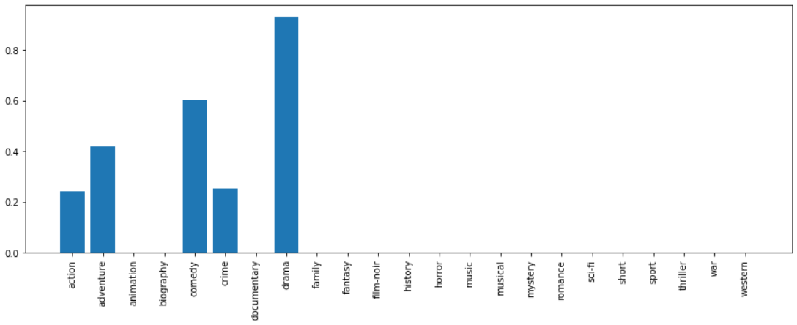
CatBoost find hyperparameters
F1 score for CatBoostModel
9

Slide 10

Example for CatBoost
“Revolves around the true story of a fateful night in August 1985 when five members of the same family are murdered at an Essex farmhouse, and the ensuing police investigation and court case that follows.”
Drama
10

Slide 11
Example for each model
“Revolves around the true story of a fateful night in August 1985 when five members of the same family are murdered at an Essex farmhouse, and the ensuing police investigation and court case that follows.”
biography crime drama
drama
11

Slide 12
Future
Collect more unique data
Add ‘superhero’ tag for labels
Train multimodal model
Add year and country as new features
12

Slide 13

Thank you for your attention

